Slide 1
INSTRUCTIONS for this presentation
This template can be used for workshops, meetings with your co-creation arena and other stakeholders. It can help to explain the CCC project. While the slides include the most important message, additional info and talking points can be found in some of the slides' notes sections.
The template aims to be versatile and flexible, allowing you to choose the slides you need for your purpose. It is in English, but you are welcome to translate it in your own language.
! Please download a copy of this presentation for your purposes and do not edit the original.
The template can be edited and ajusted over time, especially if we want to add more slides. If you think something is missing, please use the MS TEAMS Comms deliverables and intl. Dialogue channel to communicate your needs.

Slide 2
Interreg BSR project «Creative Circular Cities»
^{Place | Date} ^{Speaker} ^{interreg-baltic.eu/project/ccc}

Slide 3
Interreg BSR project «Creative Circular Cities»
^{Place | Date} ^{Speaker} ^{interreg-baltic.eu/project/ccc}

Slide 4
Interreg BSR project «Creative Circular Cities»
^{Place | Date} ^{Speaker} ^{interreg-baltic.eu/project/ccc}

Slide 5
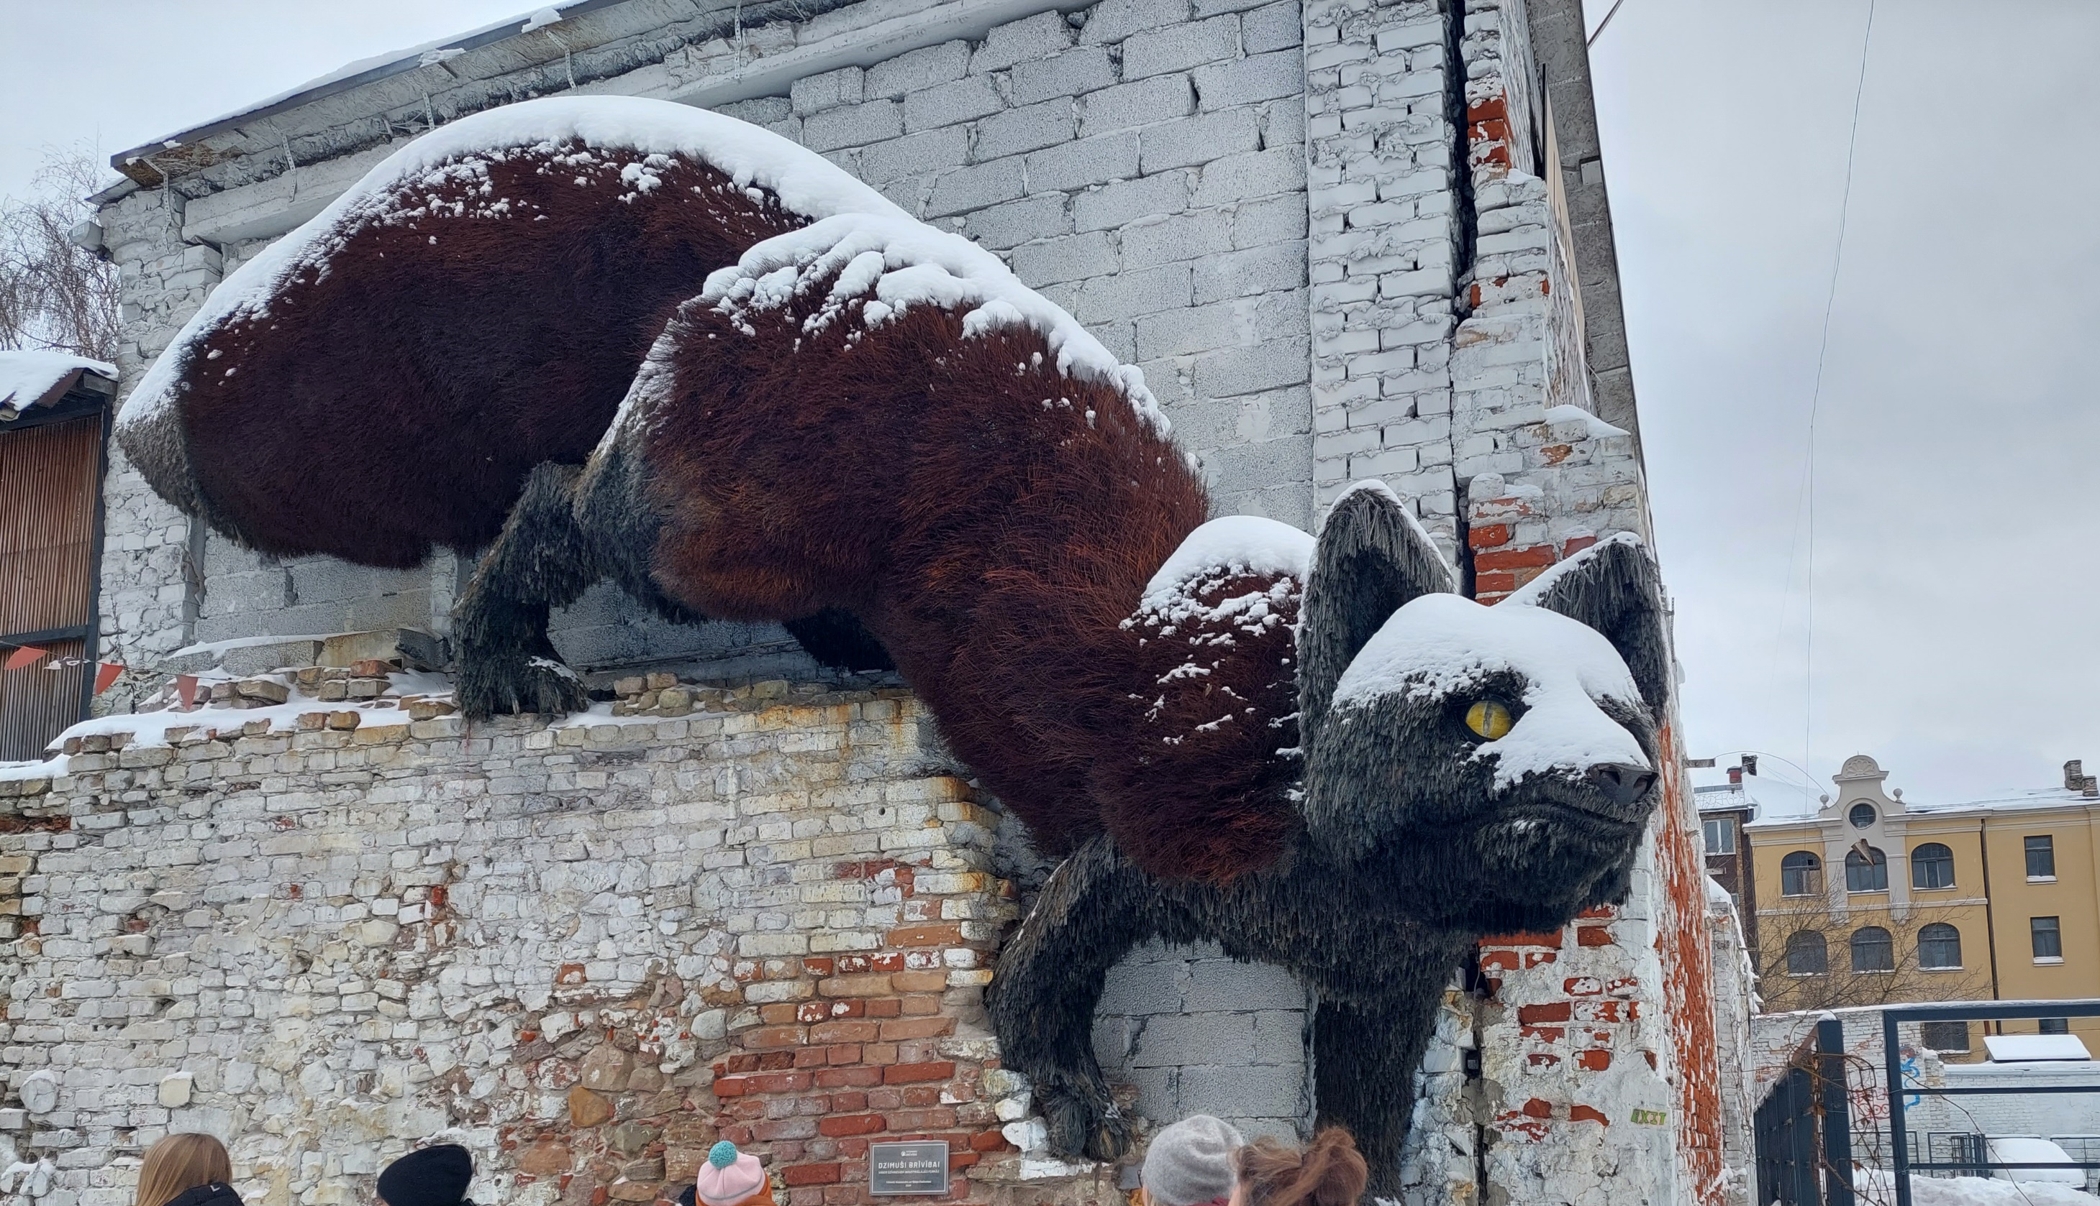
Interreg BSR project «Creative Circular Cities»
^{Place | Date} ^{Speaker} ^{interreg-baltic.eu/project/ccc}

Slide 6
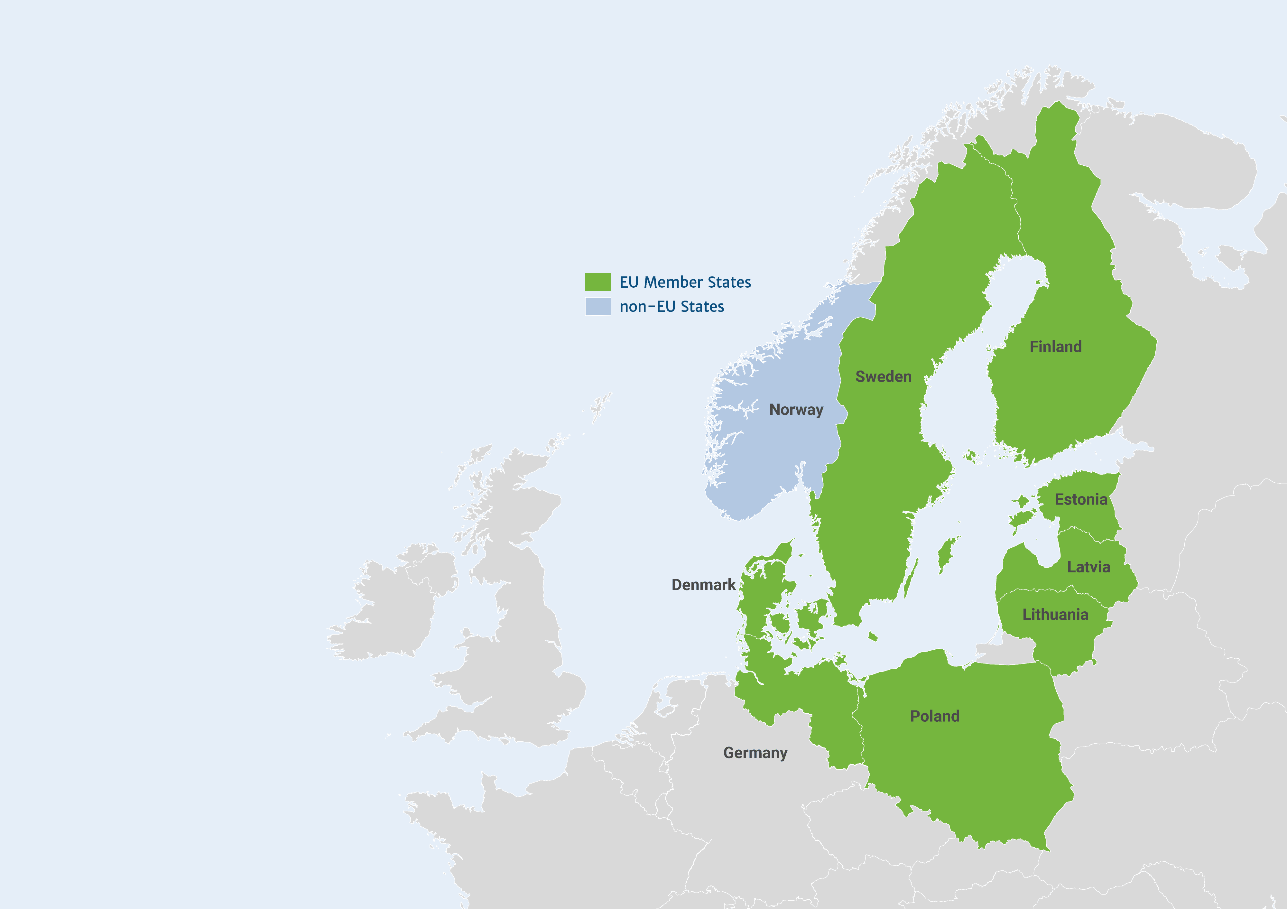
Creative Circular Cities (CCC)
“CCC brings together 14 project partners from six Baltic Sea Region cities, united in their belief that the creative and cultural sectors and industries can drive a circular economy.”
Notes:
The Interreg Creative Circular Cities project brings together 14 project partners from six cities around the Baltic Sea.

Slide 7
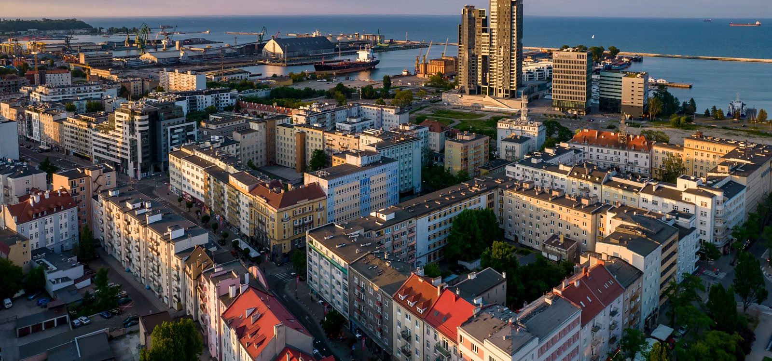
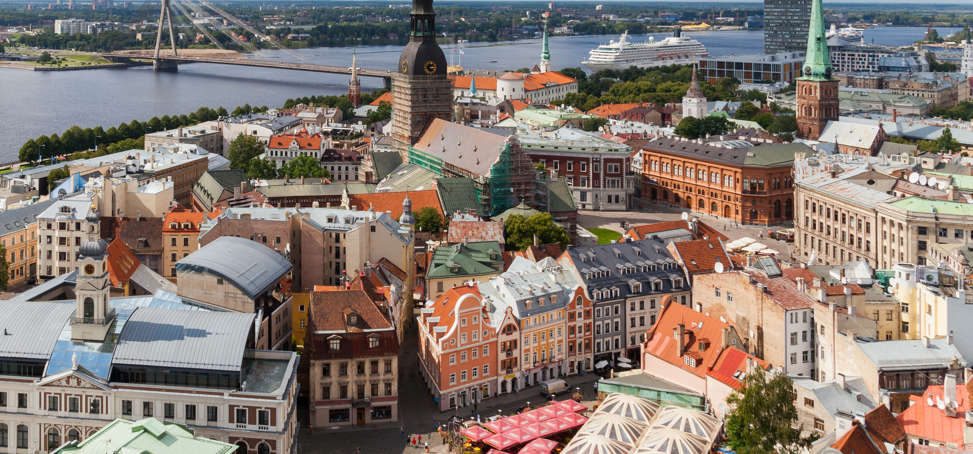
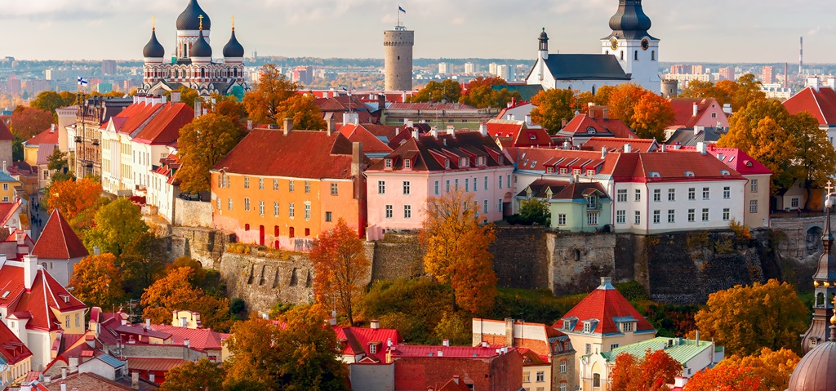
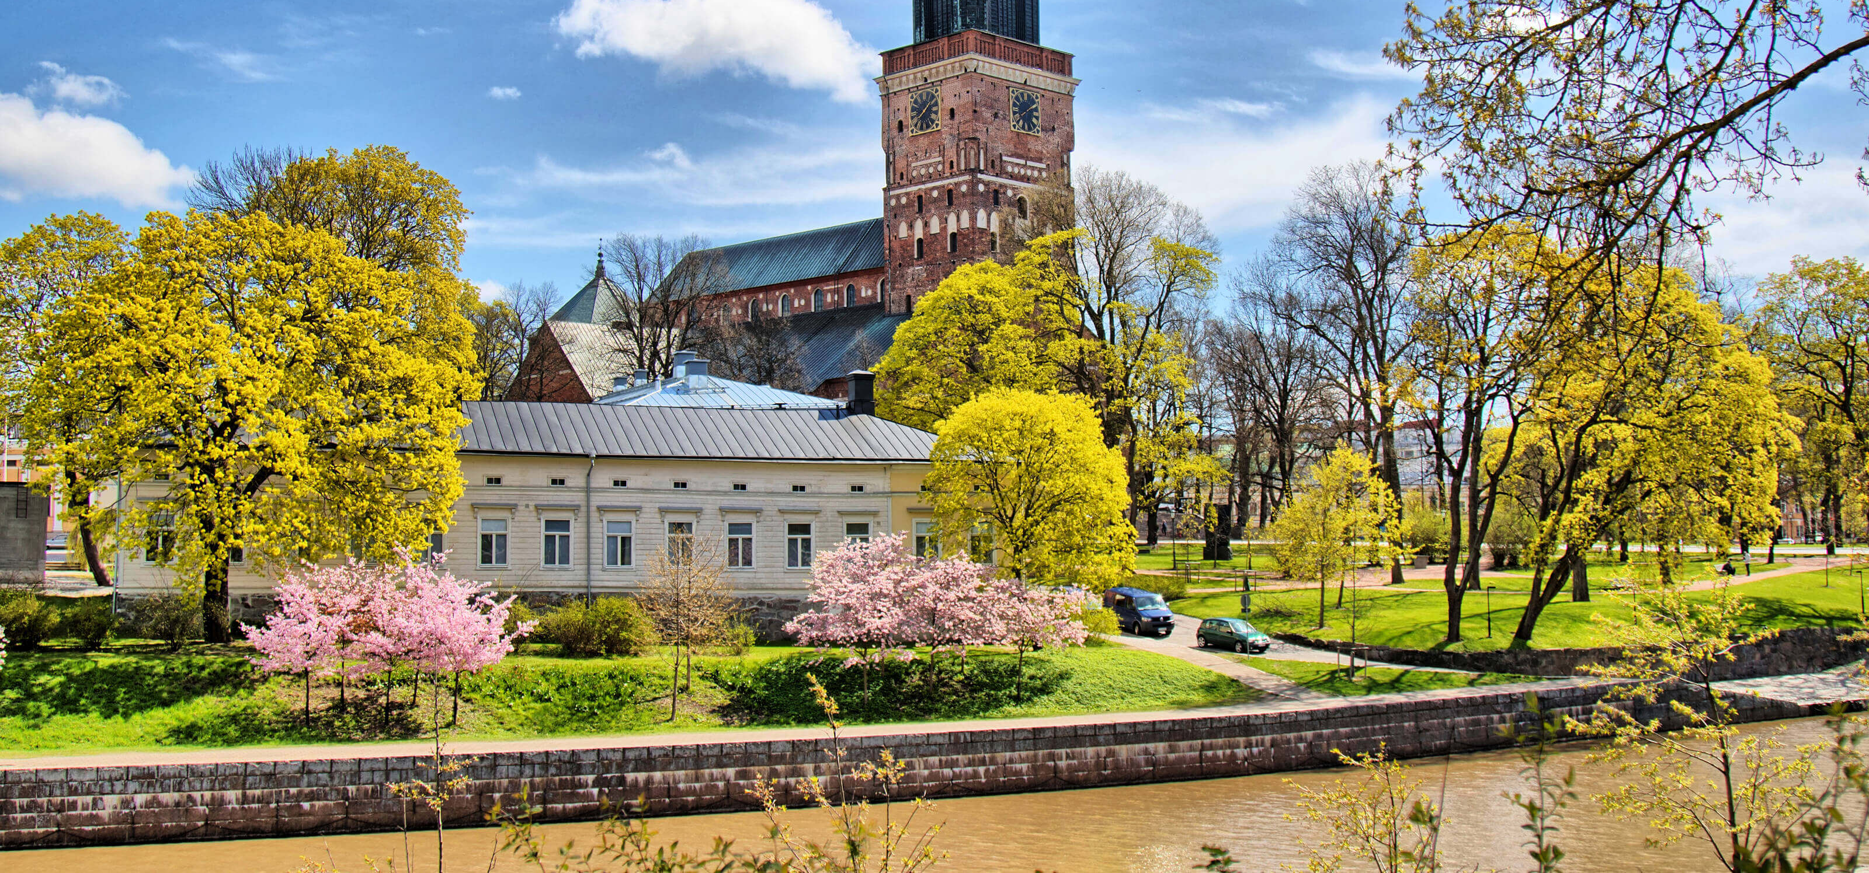
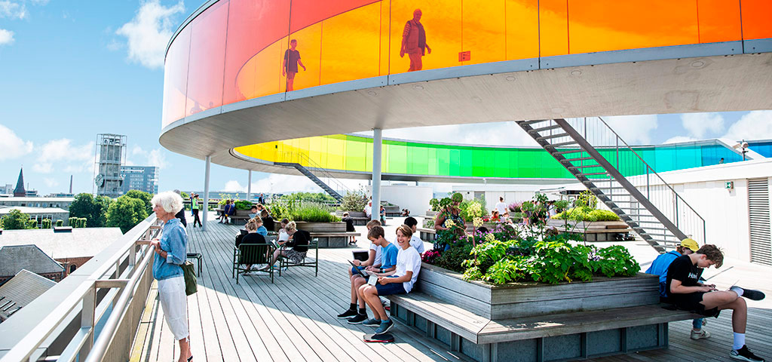
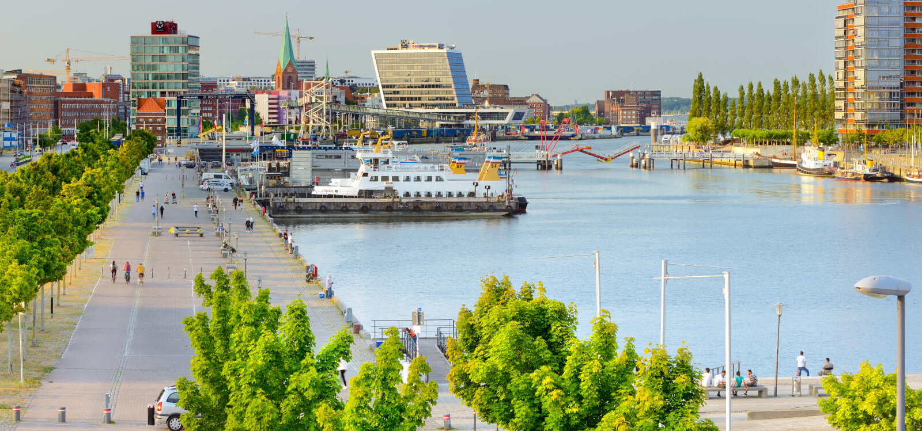
Gdynia
Riga
Tallinn
Turku
Aarhus
Kiel
Creative Circular Cities
Notes:
The Interreg Creative Circular Cities project brings together 14 project partners from six cities around the Baltic Sea.

Slide 8
Interreg Baltic Sea Region 2021 - 2027
The Interreg BSR programme is a source of EU funding that brings together cultures, perspectives and expertise to get the best ideas and joint solutions.
With the support of Interreg BSR, projects drive the transition to a green and resilient region.
Notes:
Interreg Baltic Sea Region (BSR) covers nine countries, eight of them EU Member States (Denmark, Estonia, Finland, Germany, Latvia, Lithuania, Poland and Sweden) and one third country (Norway).

Slide 9
The CCC project partners
Municipalities
Business support organisations
Non-governmental organisations
Notes:
The Interreg Creative Circular Cities project brings together 14 project partners from six cities around the Baltic Sea. The project partners can be categorized into the following types.

Slide 10
The CCC project partners
Notes:
The Interreg Creative Circular Cities project brings together 14 project partners from six cities around the Baltic Sea.

Slide 11
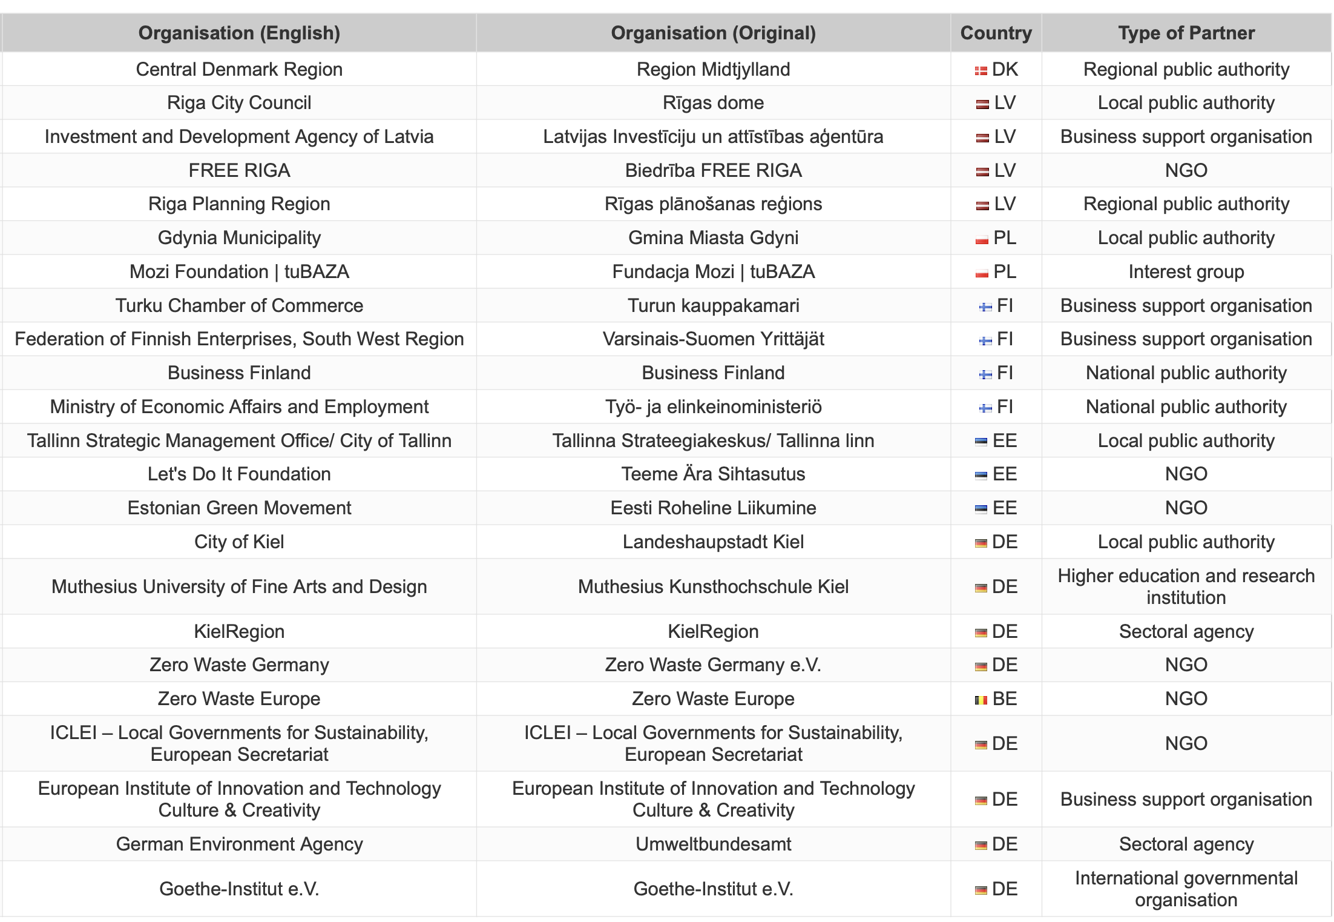
The CCC associated organisations
Notes:
The Interreg Creative Circular Cities project brings together 23 associated organisations.

Slide 12
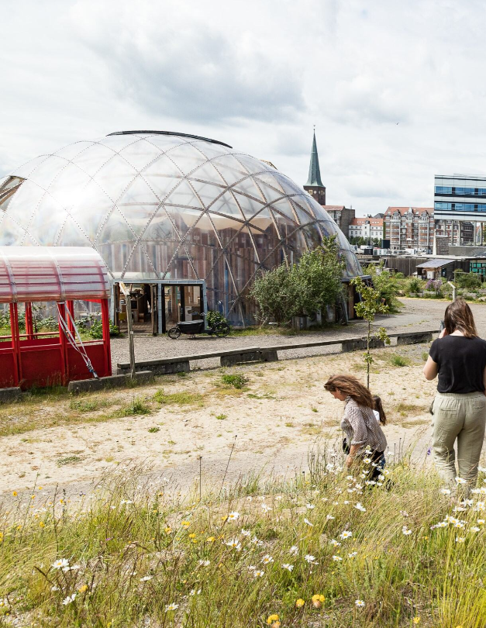
Why creatives and circular economy?
Creatives can be drivers for circular economy in the Baltic Sea region.
They are a social force with great influence on mindsets of people and can help to promote “circular lifestyles”.
At the same time, they are a business field with a considerable GDP share and a high innovation potential that can support circular business models.
Notes:
Additional information:
Local circular transition is widely acknowledged as the key first step towards a comprehensive circular economy, as it allows a “system change” that integrates the production and consumption side at manageable scale. In particular, the “dual role” of CCSI as facilitator of circular consumption and frontrunner for circular production may be utilised.

Slide 13
Current challenges
Lack of Communication
Business Challenges
Limited Involvement
Strategic Planning
Government Support
Notes:
Additional information:
Unfortunately there are several challenges that impede the integration of creative and cultural actors into cities’ circular economy activities.
Lack of Communication: There's not enough sharing of knowledge and ideas between local governments and CCSI folks, so opportunities to promote circular economy at the local level are missed.
Business Challenges: CCSI businesses need more support, like know-how, networks, and money, to develop circular models. Programs to help with this are rare.
Limited Involvement: CCSI aren't consistently involved in promoting circular economy, even though they have proven tools to engage people and change behavior.
Strategic Planning: Cities in the BSR often have strategies for circular economy or boosting CCSI, but they rarely combine the two strategically.
Government Support: National governments aren't doing enough to support circular economy locally or involve CCSI. They lack awareness, clear rules, and financial help for these efforts

Slide 14
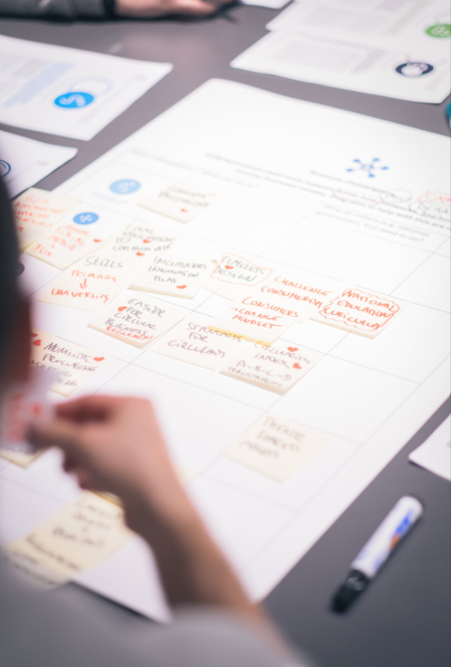
CCC activities
Through a joint learning and sharing approach, the CCC cities develop, test, and promote methods and techniques to involve cultural and creative sectors and industries in the transition from a linear to a circular economy.
Notes:
Specifically, the demo cities will carry out the following activities:
the set-up of a “co-creation arena” which brings together necessary circular economy and CCSI stakeholders for strategic dialogue
the creation of a CCSI-supported business incubation pilot
the creation of a CCSI-supported circular lifestyles pilot initiative
the implementation of local strategies combining CCSI and circular economy

Slide 15
Co-creation arena
A platform for various stakeholders to come together and discuss how to make cities more circular by involving the creative sector.
Notes:
Additional information:
In order to implement a circular transition with the support of CCSI, each demo city creates a dedicated and permanent «arena» for dialogue of circular economy and CCSI stakeholders.
CCSI-driven circular transition requires bringing diverse local stakeholders into a regular dialogue so that they share experiences, develop strategic approaches, and start up joint actions.
Municipalities and civil society initiatives (e.g. local NGOs, citizen engagement & place making initiatives), business support organisations, national authorities and regional networks must be addressed to ensure political, institutional, professional, civic and financial engagement.
Circular economy and CCSI practitioners (e.g. business incubators, public & cooperative culture centres & initiatives) must be involved to set circular transition into action.

Slide 16
Business incubation
Drawing on the expertise and skills of creative actors, business support organisations in each city help businesses become more circular.
Notes:
Additional information:
Business support organisations in the CCC demo cities lead the development and refinement of pilot business incubation programmes for facilitating CCSI-supported circular business models.
The pilots include:
Information seminars & events that equip local businesses with a basic understanding of circular business models and ways to create them with involvement of CCSI actors.
Mentoring in the process of finding business cases & developing viable business models to utilise them.
Local B2B networking that helps them to establish necessary partnerships.

Slide 17
Citizens’ engagement
With the help of creatives, each city implements initiatives which showcase how citizens can lead a more circular lifestyle.
Notes:
Additional information:
Municipalities and NGOs in the CCC demo cities lead the development and refinement of pilot citizens engagement initiatives for the promotion of “circular lifestyles” amongst citizens.
The pilots show that CCSI are a social force with great influence on the mind sets of people. They are implemented by demo cities’ in collaboration with local actors from the CCSI domain and the circular economy domain and focus on low-threshold approaches (e.g. surplus-food dinners, circular arts exhibitions, Circular Economy Carnival) that can be used to start up circular transition on neighbourhood level - and be easily transferred to other locations.

Slide 18
Strategy development
Each city develops a strategy, which assigns dedicated roles and responsibilities for creative and cultural actors in the journey towards a circular economy.
Notes:
Additional information:
Municipal actors from the six demo cities lead the development of strategic approaches for involving CCSI into the circular transition at local level.
The strategies will demonstrate how measures on the production and consumption side of circular economy can be combined into integrated approaches for CCSI-driven circular transition at local level. These strategies will form the basis for continued action at city-level.

Slide 19
Implementation of CCC activities
Throughout the three year implementation period of the project, the CCC activities are structured in three work packages.
Preparation
Testing
Dissemination
Notes:
During work package 1, the CCC demo cities prepare their pilot activities through local preparatory work as well as transnational workshops, that serve as a platform for knowledge exchange and inspiration.
During work package 2, the pilots are tested in the cities and throughout the testing phase the successes and challenges of the pilots are assessed and learnt from.
During work package 3, the cities disseminate their learnings and knowledge at national and international events. It is important to present project results to other potentially interested parties.

Slide 20
Outputs and deliverables of the CCC project
Play books
Case studies
PR materials
Guidance papers
Explanatory movies
Blue prints
infographics
Notes:
Additional information:
The learnings and results of the CCC project will be captured in a «CCC Starter Kit» in the shape of guidance papers, play books, explanatory movies and much more. The Starter Kit will be a publicly available repository of resources and materials that allow other interested parties to learn from and potentially replicate the activities of the CCC project.
Further, an easy-to-use PR toolset with materials, such as presentations, infographics and facts on the integration of CCSI and circular economy will complement the CCC Starter Kit.

Slide 21
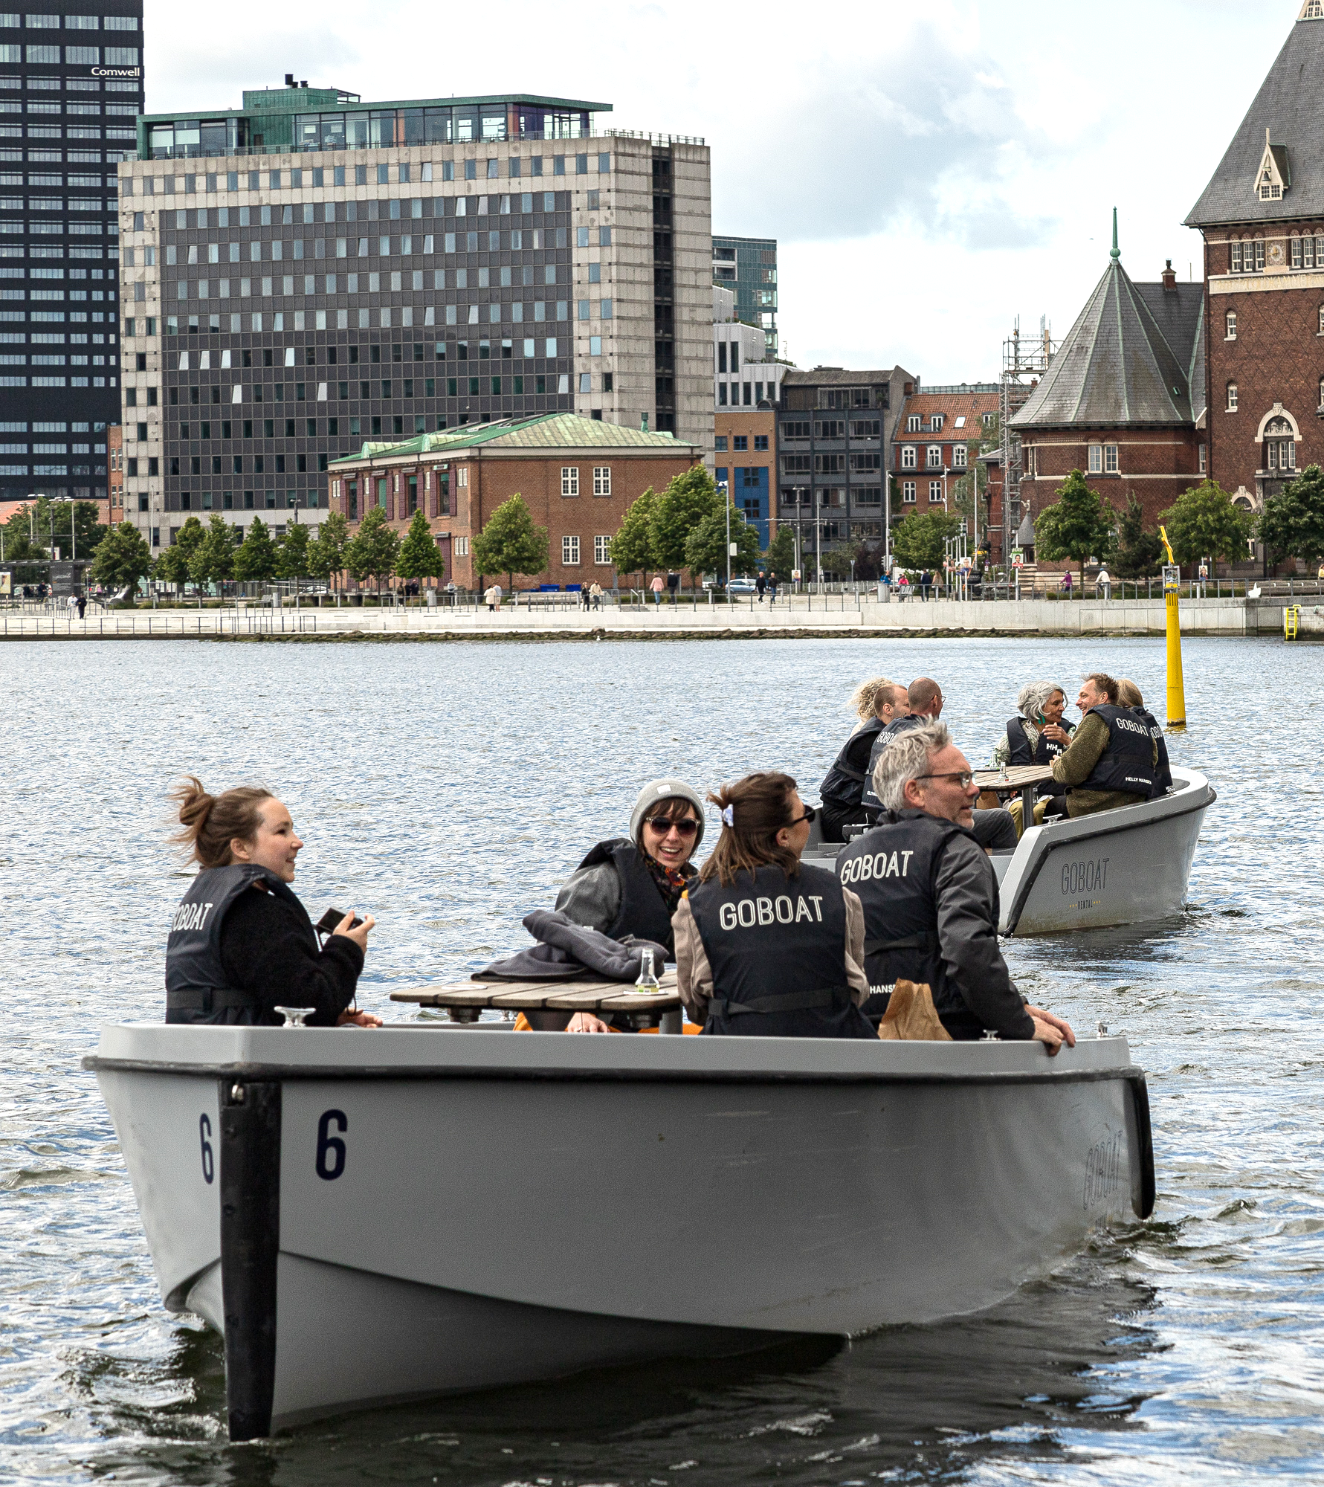
Looking for more information?
Website
The CCC website presents information on the project itself, related news and events as well as press releases. It the central place for everything related to the CCC project.
interreg-baltic.eu/project/ccc/
LinkedIn
The CCC LinkedIn page regularly informs about the progress of the CCC project,but also highlights related activities in the CCC project cities.
Linkedin.com/company/creative-circular-cities/
Instagram
The CCC Instagram account showcases circular practices from the project cities and beyond.
https://www.instagram.com/creativecircularcities/

